Slide 1
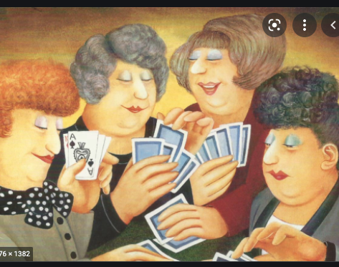
English Bridge Union (EBU)
Free trial period for unaffiliated clubs and their members

Slide 2
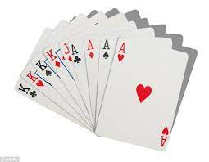
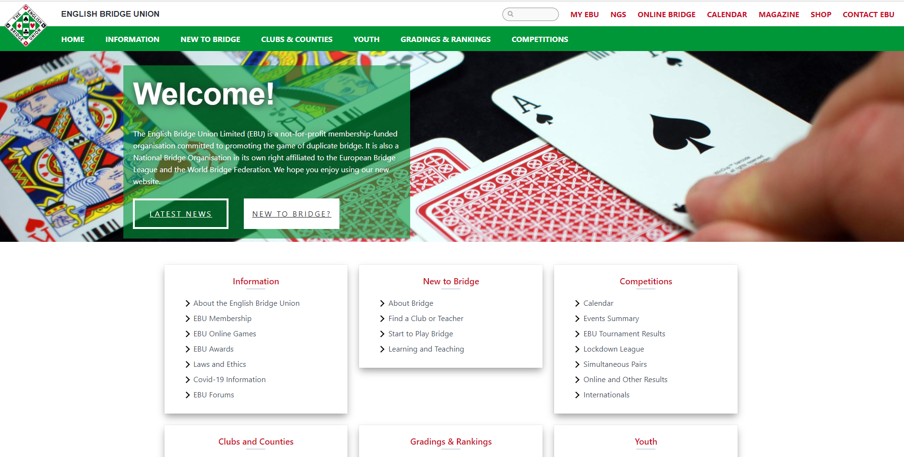
Topics
About the English Bridge Union (EBU)
Why Affiliate?
Benefits to the Members
Benefits to the Club
National Body
Special Membership Offer

Slide 3
What players appreciate about the EBU
“The directors were so friendly and helpful”
“I remember when I reached Local Master – everyone was so congratulatory. The first milestone of many.”
“I just love the EBU overseas congress. They are really friendly and have definitely helped me improve my Bridge. I had only been playing a couple of years when I first went and have never looked back.
.”
”Everyone is always welcoming and friendly”
“A great way to socialize during and after the game”
”Would not have survived without online bridge during lockdown”
”I love to meet new players and old friends”
” I think having a National body is very important for ensuring rules, regulations and fair play. I have also enjoyed kibitzing our England players.
As someone living on my own, bridge has been a lifeline. I can walk into any EBU club, anywhere, and instantly I am welcome and I feel at home
“I love the morning seminars and playing against lots of different players – I always learn a lot”

Slide 4
About the English Bridge Union (EBU)
A Not-for-profit membership-funded organisation
Committed to promoting the game of duplicate bridge for all players of all standards
The National Bridge Organisation of England
Affiliated to the European Bridge League and the World Bridge Federation
39 Counties
600 clubs
58,000 members
EBU
A small team of approachable and helpful staff at the Aylesbury Head Office.
Led by an unpaid Board of Directors that supports
a countrywide volunteer network of shareholders, counties and clubs.

Slide 5
Why Affiliate to the EBU?
Benefits
What other clubs appreciate
Allow your members to gain the most from the game
Excite them by showing their progression and success
Allow them to participate as equals in inter-club, county and EBU events
Give the club the benefits of all the tools, human and other resources, that are available from the EBU, your county and other clubs:
Wealth of resources and services from the EBU
Enjoy the support of your county
Benefit from the experience of other clubs that have been running successfully
Be part of a national body that supports bridge for all
.
“Competitions the EBU runs”
“Advice on providing competitions for less experienced players.”
“Expertise and advice offered especially by Jonathan Lillycrop. Handling of conduct issues”
Try it out for free – see if it suits your club and its members
“The bridge community needs to come together to bring more and younger players into the game”
“National 'face'/presence, national co-ordination.”
“EBU is approachable and friendly”
Moving play to on-line;
Providing advice for the future by email and via the web site;
Providing telephone support/advice when needed;

Slide 6
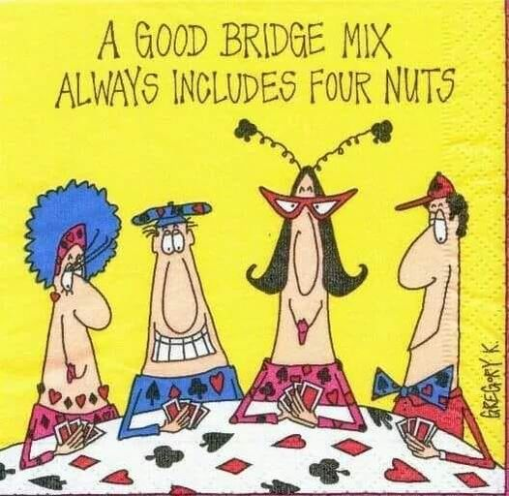
1. The Benefits of Affiliation to your Members
Benefits
Greater range of games: Play local, county or nationally with players of a similar level or a range of levels
Awards: See and track achievement through master points and NGS. This often creates great momentum and added interest in the game as players get recognition of their achievements.
Personal Information: Use the dedicated MyEBU page to review all your bridge sessions.
Magazine: English Bridge is the magazine produced by the EBU four times a year with an online publication once a year. (If the player has played a few times).
Bridge diary: A diary is circulated each year with your August magazine.
Fringe Benefits: schemes offered by HMCA (The Hospital & Medical Care Association); insurance broker discounts; and driving and horse riding training discounts with IAM Roadsmart and Rider courses.
Bridge Community: be part of the local, county, national and worldwide bridge community
Try it out for free – see if it suits your club and its members
Allow your members to take advantage of your affiliation ….

Slide 7
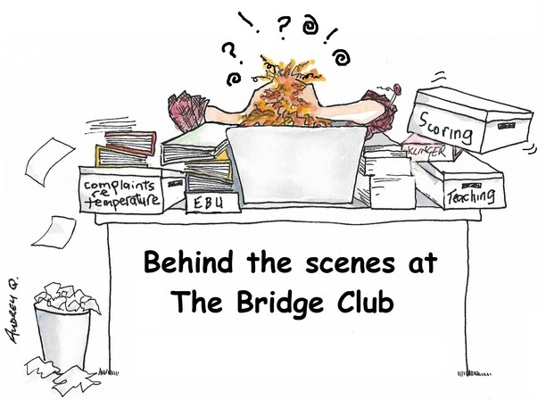
2. The Benefits of Affiliation to your Club
Let the EBU Ease Your Burden
Dedicated Club Liaison Officer to help with all aspects of running your club - available full time
Club Management Handbook providing advice on all aspects of the management for a club from setting up a committee to ideas for the clubs’ Christmas party!
EBU does your administration with some online platforms (BBO) saving much time
Downloadable forms such as System Cards, Model Club Constitution
Free EBUScore to automate your scoring
Free Website for your club supplied by Pianola
Reduced costs of insurance cover
Reduced costs of equipment
Try it out for free – see if it suits your club and its members

Slide 8
2. The Benefits of Affiliation to your Club
The EBU can help your Club Expand and Develop
Dedicated Club Membership Development Officer to help clubs extend their membership
Take advantage of club competitions - The EBU runs a number of competitions especially for its clubs.
Free Club Teacher Training - EBU affiliated clubs receive a free club teaching training place every two years.
Club Tournament Director Training - Every EBU club receives a discount on the cost of Tournament Director Training Courses
Assistance with any difficulties that your club experiences from financial problems to behaviour of members
Assistance with changes such as COVID and its aftermath
Allow the EBU to publish details about your club to attract suitable new players
Try it out for free – see if it suits your club and its members
Bridge on Mars

Slide 9
2. The Benefits of Affiliation to your Club
Enjoy the Services and Support From your County
To be completed by each county
Suggestions to include are:
Competitions for club and players
Promote and advertise the club through email lists, website
Support of county personnel
Experience and contacts with other clubs
Try it out for free – see if it suits your club and its members
This page is specific to your county.

Slide 10
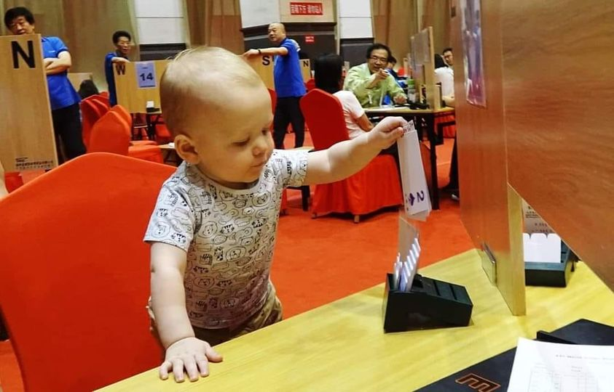
2. The Benefits of Affiliation to your Club
Be informed and be Part of the Bridge Community
Club Management Focus – electronic newsletter especially for club administrators with up-to-date information
Benefit from the EBU Web site with a treasure trove of resources to help run your club – continuously developed and refined over several years
Work with other clubs, your county and the EBU to promote and encourage younger players
Join in with others to Promote the game and ensure the game is welcoming and friendly to newcomers
Link with, and benefit from, the support of the other 600 clubs and your county with their dedicated (unpaid) committee members and other volunteers
Enjoy games against other clubs and in county events
Try it out for free – see if it suits your club and its members

Slide 11
3. Be Part of a National Organisation
A National Organisation
Promote the benefits of the game across the country including well-being and social benefits so that everyone can benefit
Promote bridge to young people across the nation in a coordinated fashion
Work with the Government and other bodies to ensure that bridge gets fair treatment
Work with international Bridge organisations to enable England and Great Britain to be represented in international competitions and to influence the future of bridge internationally
Coordinate responses to changing circumstances; this was especially critical in COVID and will be in the return to normal life post COVID
Keep up-to-date with bridge developments and ensure they are known throughout the bridge community
Try it out for free – see if it suits your club and its members

Slide 12
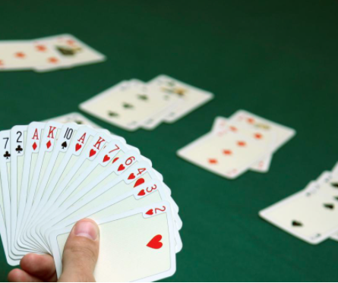
The Offer – A Trial Period of Free Membership
Free membership to club members between October 2021 to September 2022 - no fee is paid to the EBU for playing in the club during this period.
Club members will enjoy all the benefits of membership including:
Master points that celebrate achievement and improvement and a grading system
Free Magazine
Inter-club competition
Ability to play in county and national events
Free membership for clubs until April 2023
Not all club benefits will apply. The following will:
Full support for clubs from EBU personnel and associated tools and information
EBUScore (a scoring system for clubs)
Ten per cent reduction on training for one director
To assist the clubs through the process of affiliation, full support will be provided by the EBU.
Try it out – see if it suits your club and its members
English Bridge Union – To bring bridge to everyone

Slide 13
The Offer – Eligibility
The offer is extended to:
Clubs that have never been affiliated or have been unaffiliated since 2010
Clubs that have joined to form a single club following ‘lock-down’
if any such new club is not affiliated and
providing not all its constituent clubs were previously affiliated
The offer is not extended to:
Clubs that have affiliated after 2010 and subsequently disaffiliated.
Clubs that have recently affiliated
English Bridge Union – To bring bridge to everyone

Slide 14
Financials
Outside of this offer the normal financials are:
Clubs pay £27 a year
Each time a player plays, 40p is paid; if a player plays once a week this is about £20 a year or about £1.50 a month
EBU makes these charges so that they approximately cover the costs of providing the services to clubs and members (EBU is a non-profit organisation)
English Bridge Union – To bring bridge to everyone

Slide 15
Next Steps
For more information or to accept this offer, please contact:
Jonathan Lillycrop - Club Liaison Officer
Gordon Rainsford - Chief Executive
Your Club Contact -
Or visit the EBU website: Club-enquiry
jonathan@ebu.co.uk
01296 317206
gordon@ebu.co.uk
01296 317222
TBC
TBC
English Bridge Union – To bring bridge to everyone

